Slide 1
Monday, September 12, 2016
Write In Your Agenda:
Write In Your Monitoring Log:
CW:
Finish “Puzzling Pangaea”.
“What is Pangaea?” PPT and notes sheet.
HW:
None.
Response to Warm-Up:
Describe (compare and contrast) the shapes you received Friday and the 7 continents that exist today.
You will need:
Pencil
Puzzling Pangaea
Hand in signed Monitoring Log.

Slide 2
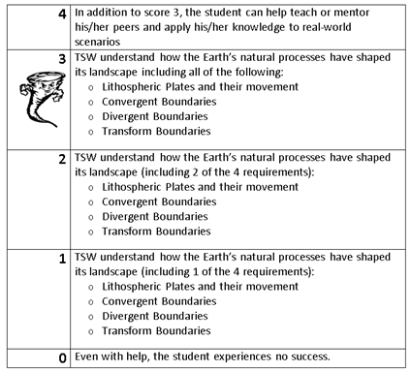
Learning Goal and Scale
TSW understand how the Earth’s natural processes have shaped its landscape (including Lithospheric Plates and their movement, Convergent, Divergent, and Transform boundary landforms).

